Slide 1
leveraging JS tracking to personalize online advertisements
Notes:
LETTEN OP INTONATIE
In other words, I’ll be showing another possible use of JavaScript

Slide 2
Table of contents
1. On marketing
2. How the Facebook Pixel code tracks you
3. How marketeers use this information to create highly personalized ads
4. Ethical and legal considerations
5. Questions and remarks
Notes:
2. This won’t be a tutorial, but you’ll get a general view of how things work
My main message is that
You can use Javascript to track behaviour on your site and then use this information as input to create highly personalized advertisments

Slide 3
1. On marketing

Slide 4
Why a website/app?
(someone, have a guess)

Slide 5
Why a website/app?
A tool for a goal
User goals
Business goals ($$$)
Notes:
USERS
Only friends, family and fools visit a website without a purpose
More often, there’s something the visitor wants: to order something, to entertain themselves
BUSINESS
Developers do have hobby projects, there are people who do it for free
More often, business use websites to make money

Slide 6
Marketing
“the action or business of promoting and selling products or services, including market research and advertising.”
Notes:
One of the ways businesses get people to their shops is by advertising
Online advertising is a marketing tool.

Slide 7
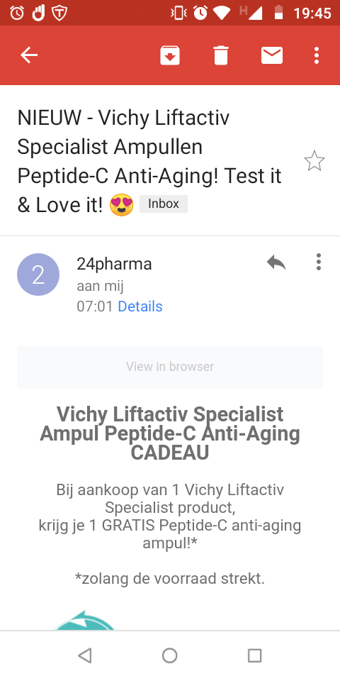
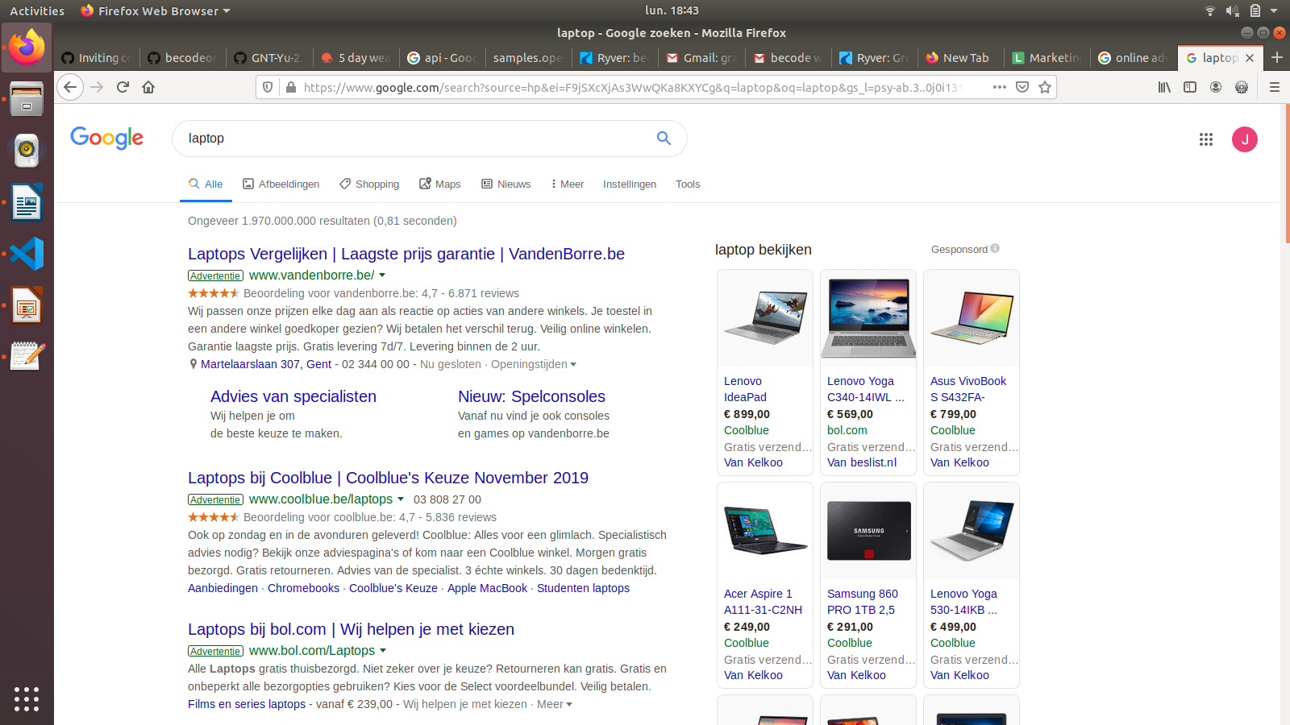
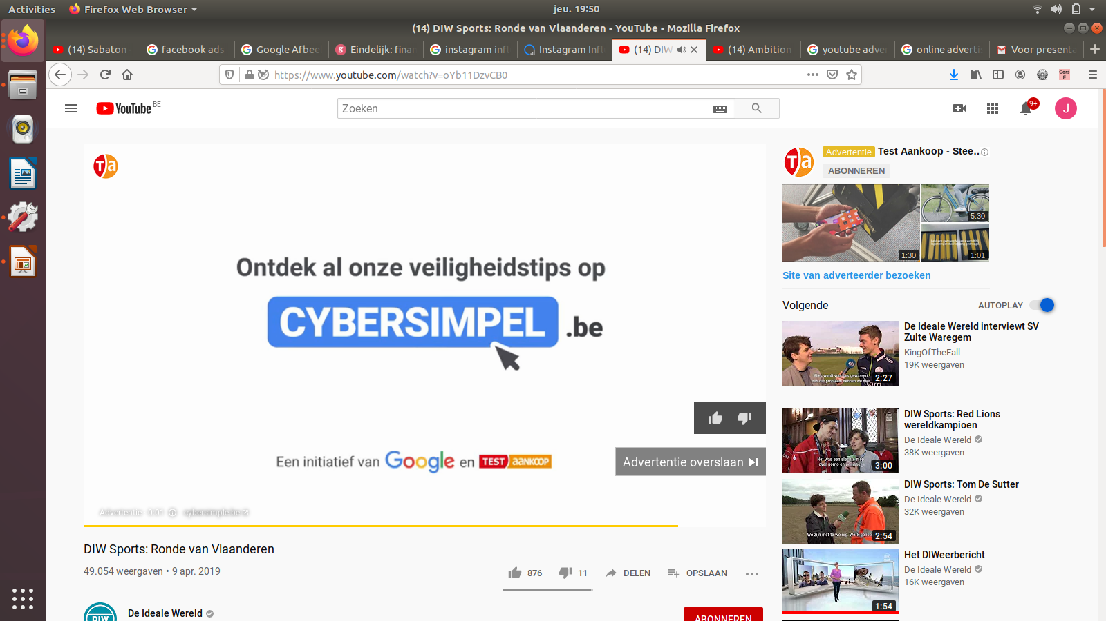
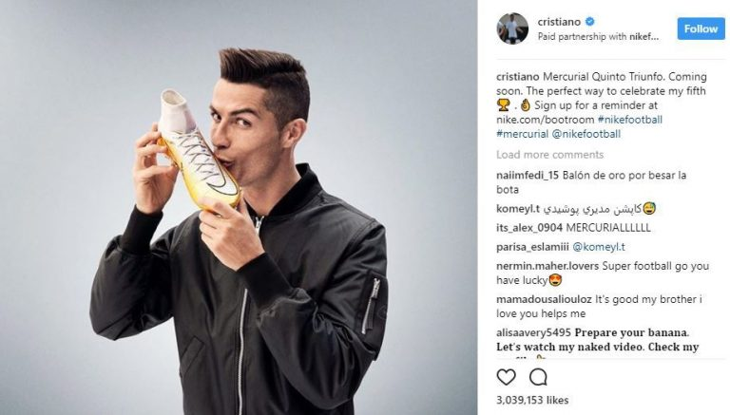
Online advertisements
Notes:
It’s a big topic
There are many terms
SEA, for instance, stands for Search Engine Advertising and it’s the paid counterpart to SEO
So there are many forms of online advertising, many platforms you can use, many strategies you can use

Slide 8
What’s the most effective way of advertising?
(everyone, by show of hands)
a) Ads on Google’s Search Result Page for “laptop”
b) E-mail marketing based on earlier purchases
c) Influencer kissing a product
d) YouTube video based on user’s interests profile

Slide 9
What’s the most effective way of advertising?
Trick question!
Depends on what you want to do
More customers
A) Ads on Google’s Search Result Page for “laptop”
d) YouTube video based on user’s interests profile
Foster interest
C) Influencer kissing a product
Short-term profit
B) E-mail marketing based on earlier purchases
c) Influencer kissing a product
Notes:
B) e-mail to former clients is a good way of getting short-term revenue, but the client base remains the same
A) showing your products for generic search queries such as “laptop” gets your brand noticed. In the long term, this grows your business
C) knowing a product exists, however, is not enough. You need to want it, desire it. If you like Christiano Ronaldo or another influencer, him kissing a product moves you toward actually wanting and buying it

Slide 10
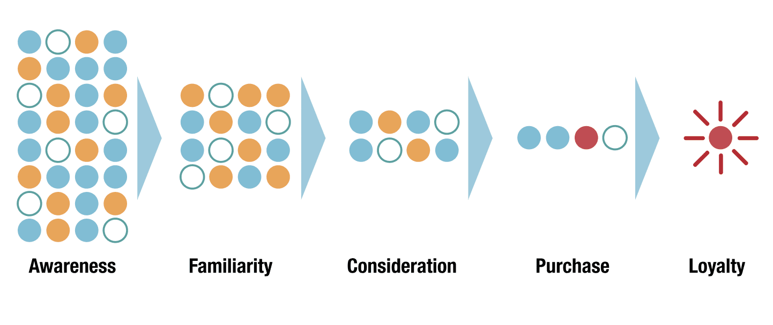
Customer journey to conversion
More customers
A) Ads on Google’s Search Result Page for “laptop”
d) YouTube video based on user’s interests profile
Foster interest
C) Influencer kissing a product
Short-term profit
B) E-mail marketing based on earlier purchases
D)
C)
My example
B)
A)
Conversion
c) Influencer kissing a product
Notes:
we can map these things on a customer journey towards conversion, most often a purchase
People don't immediately buy something, they need convincing and they move through different stages
I'll expand upon one strategy that is situated in the consideration phase, just before the actual purchase. This strategy leverages the possibilities of JavaScript tracking

Slide 11
2. How the Facebook Pixel code tracks you

Slide 12
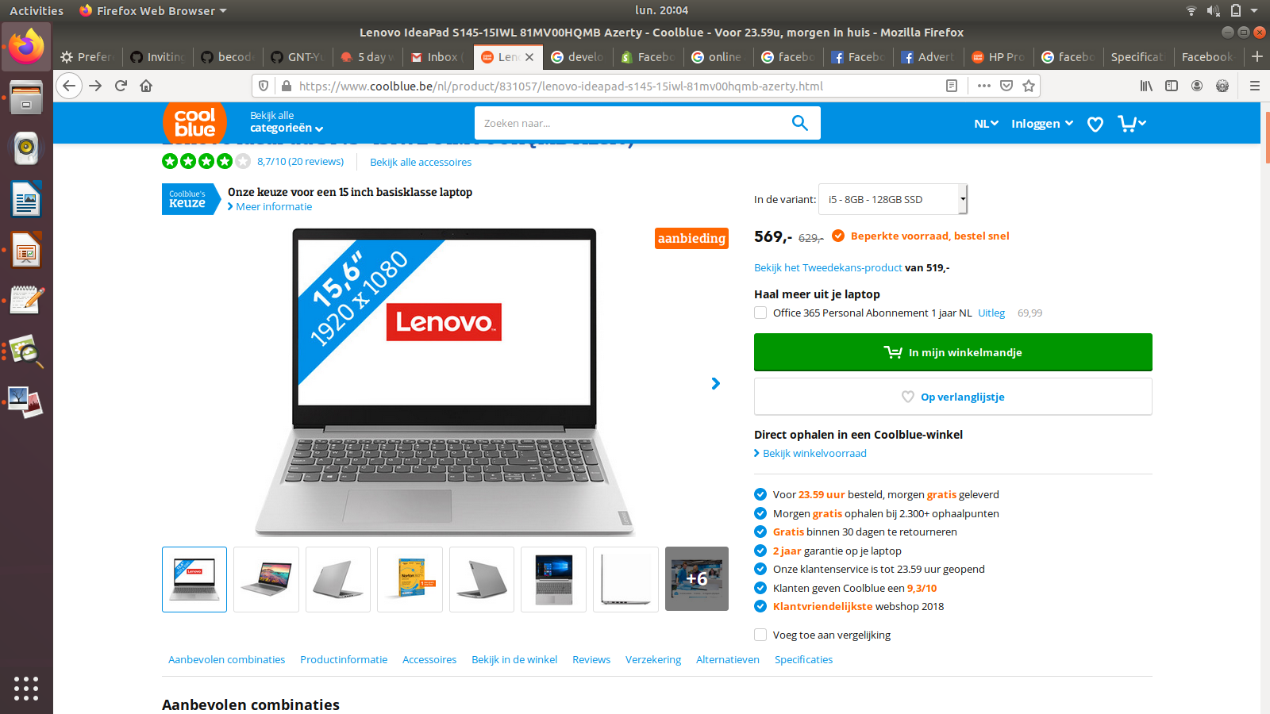
Viewing a product on a website
Notes:
Let’s look at an example
So you want a new laptop and are interested to learn more about this specific type. It’s sort of in your price range, looks nice, … and so you load the page
The consumer sends this signal and with JavaScript, the company can capture that signal in order to act upon it

Slide 13
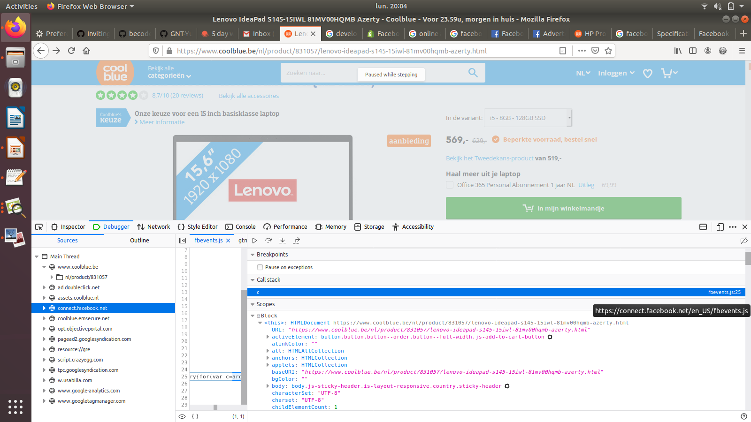
Facebook code registers said viewing
Notes:
How do we capture that signal?
Javascript is active in the background
We see the thing change when you click a button
Asynchronous, by the way

Slide 14
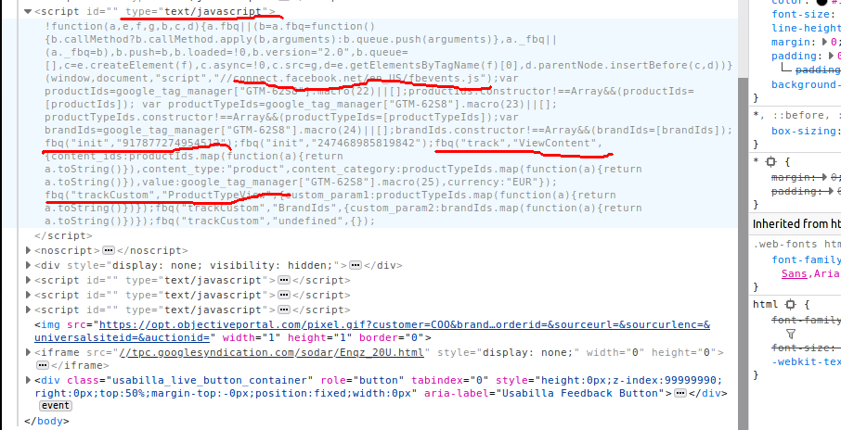
Too long, didn’t read
Notes:
If you look in console, you can see Facebook code
It’s not very readable, but some things are

Slide 15
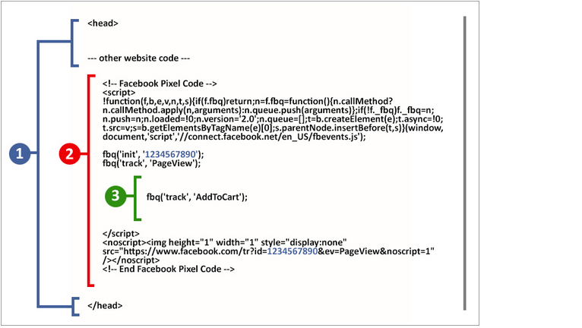
A simplified view of the code
Notes:
The developer documentation offers a clearer picture
There’s this thing called the Facebook Pixel, which tracks you
You put it somewhere between your own code
There’s a basic set-up that just tracks all the pages that are viewed
But you can also track events, things that happen on the site, such as adding the laptop to your shopping cart
I won’t bore you with how all this works exactly (a library is loaded, cookies are set ...), but cookies are involved. Danny will talk about cookies during his watch. Again, this is not a tutorial

Slide 16
3. How marketeers use this information to create highly personalized ads

Slide 17
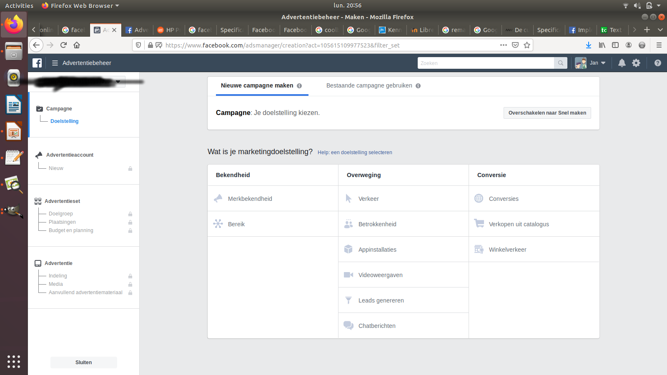
Facebook Ads Manager
Notes:
Marketeers see this point-and-click-interface to create ads.
Of course, everything can be automated, but that would complicate things

Slide 18
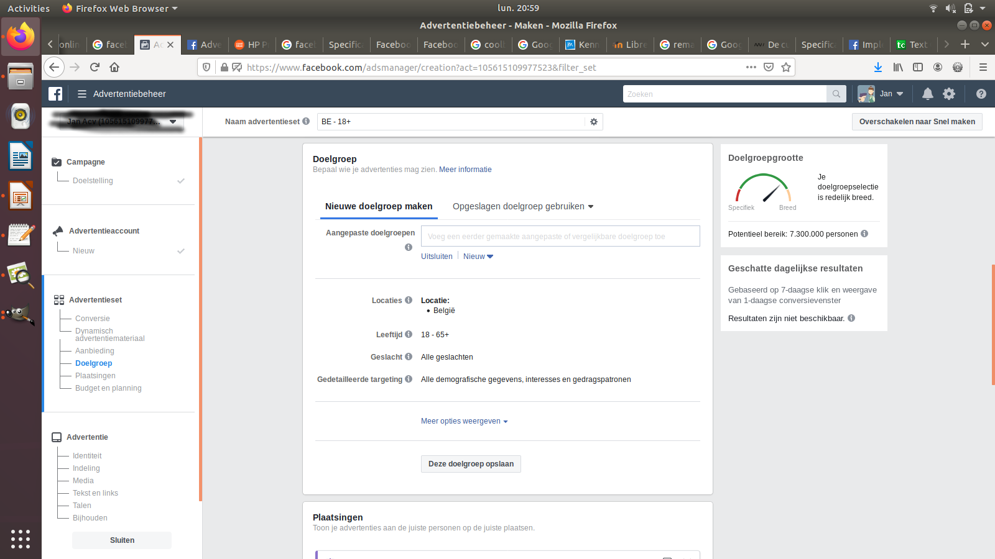
Pick your ‘target’
Notes:
Here they can choose what people to target
There’s things like gender, age, location …

Slide 19
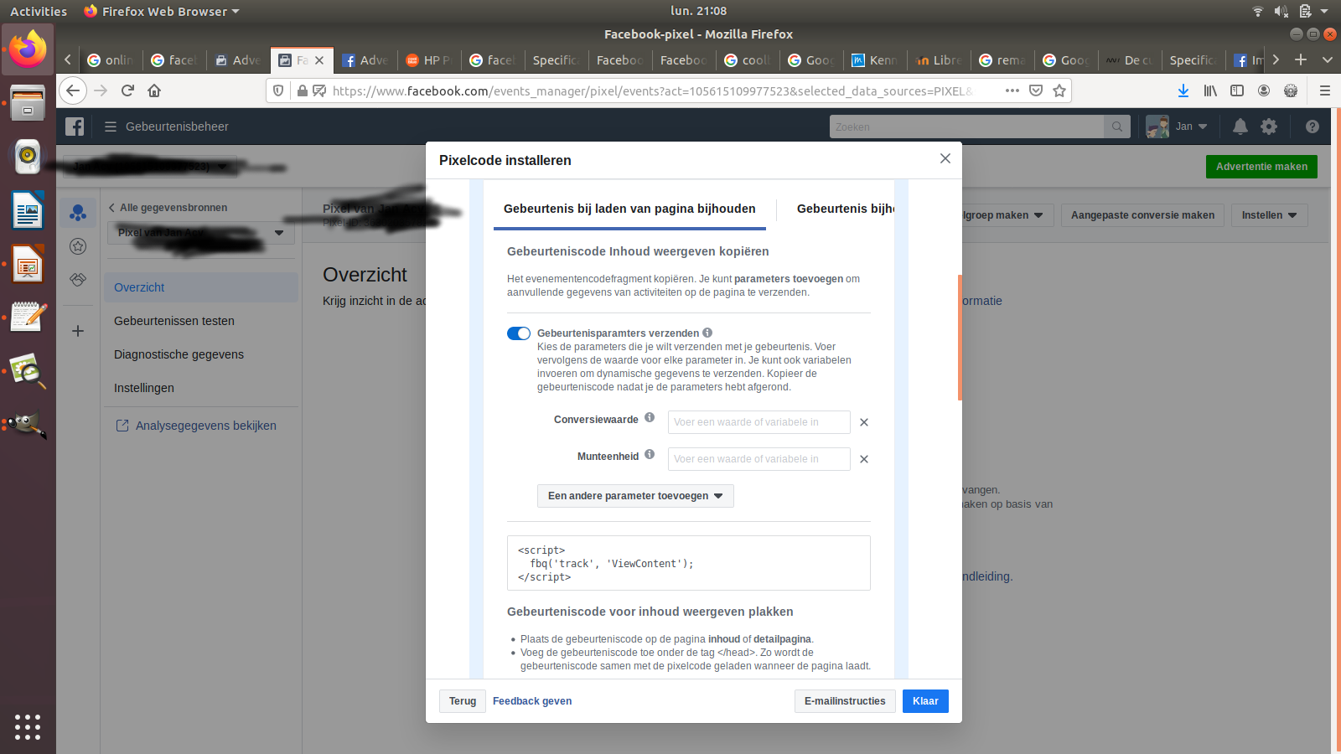
Create JavaScript-based target groups
=>
Notes:
And then there’s the possibility to create groups to target, based on specific events that take place on your site, such as looking at a product, adding it to a cart … All of which are registered by Javascript

Slide 20
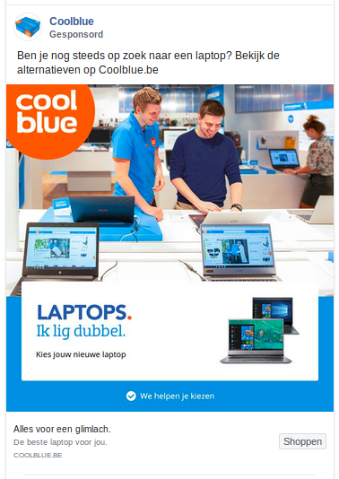
Creepy follow ads!
“Remarketing (also known as retargeting) is the tactic of serving targeted ads to people who have already visited or taken action on your website”
Notes:
… and that’s one of the reasons why, when you look at a product online, it starts to follow you. It’s kind of creepy, I know. The marketing term is ‘remarketing’ or retargeting

Slide 21
4. A note on ethics and laws
Notes:
In other words, I’ll be showing another possible use of JavaScript

Slide 22
4. Legal and ethical considerations
Highly controversial
Commerce versus privacy
Fake news and political manipulation
Individual choice or collective responsibility
GDPR and other legislation
Notes:
There are some ethical and legal limitations to consider and respect

Slide 23
Recap
A website serves a purpose
Online advertising is one marketing tool
JavaScript code tracks your online behavior
Marketeers can then create personalized ads
Not everything is allowed
Notes:
My main message is that
You can use Javascript to track behaviour on your site and then use this information as input to create highly personalized advertisments

Slide 24
5. Questions and remarks
Thanks for listening
Questions?
Remarks?
Have a good afternoon

